Slide 1





Manga Recommender System
漫画
Alwaleed Alhazmi

Slide 2
Outline
Introduction
What is manga?
Data
EDA
Model
Web app demo
Future improvements

Slide 3

漫画
01
Introduction

Slide 4
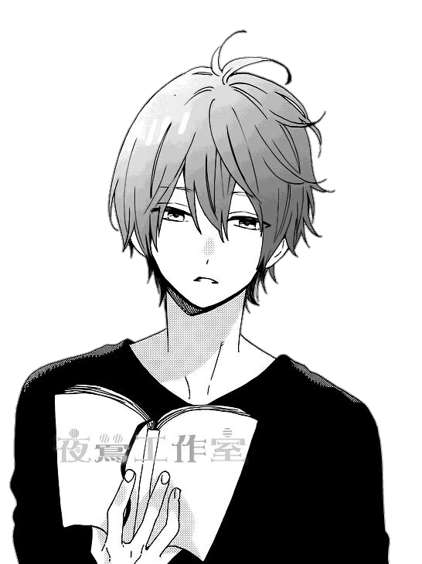
Introduction
With a long history deeply rooted in the rich Japanese art, manga are one of the most fascinating phenomena in Japan and the whole world.

Slide 5

Introduction
Introduction
From history and teenage romance to futuristic science fiction and profound themes of life, manga became an important, almost inevitable aspect of Japan’s identity and they helped spread knowledge and understanding of it across the planet.

Slide 6
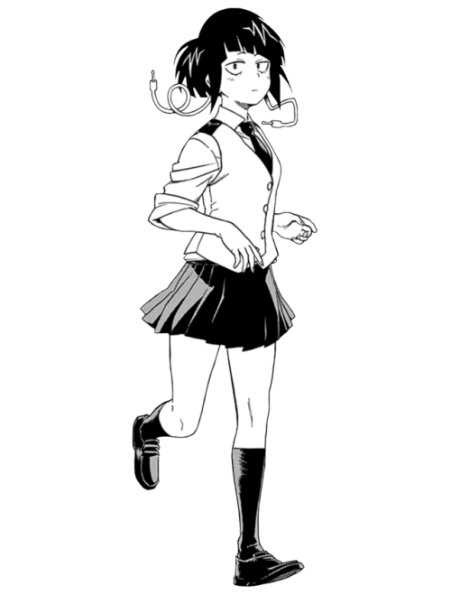
漫画
02
What is manga?
A Brief History

Slide 7
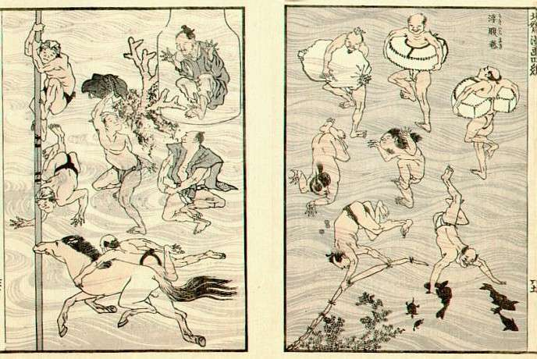
What is Manga? A Brief History
What many believed were the very first manga in Japan appeared in the 12th and 13th century, in a series of drawings like frogs and rabbits titled Choju-giga (Scrolls of Frolicking Animals) produced by several artists. In fact, their technique of drawing a characters’ legs to simulate running was adopted by many manga-ka (manga makers and comic book artists) working today.
During the Edo Period (1603-1867), another book of drawings, Toba Ehon, embedded the concept of manga, yet the term itself was first used in 1798, to describe the picture book Shiji no Yukikai (Four Seasons) by Santō Kyōden. In 1814, it showed up again, as the title of Aikawa Mina’s Manga hyakujo and the celebrated Hokusai Manga books of drawings by the famous ukiyo-e artist Hokusai.

Slide 8
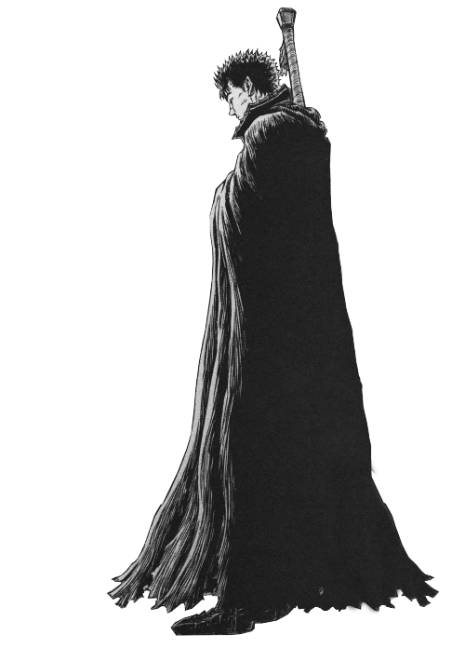
Data
Data was collected from Mangadex as JSON files
Before any cleaning the data has 60000 rows and 20 columns
Some columns were added after scraping Mangadex
Most of the columns are in lists

Slide 9
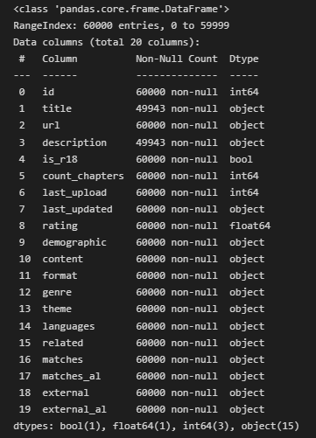
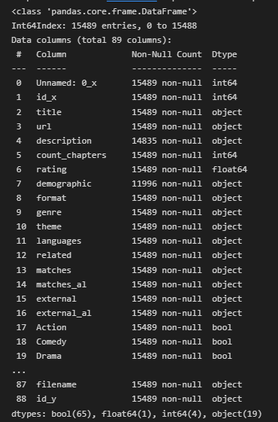
Data

Slide 10
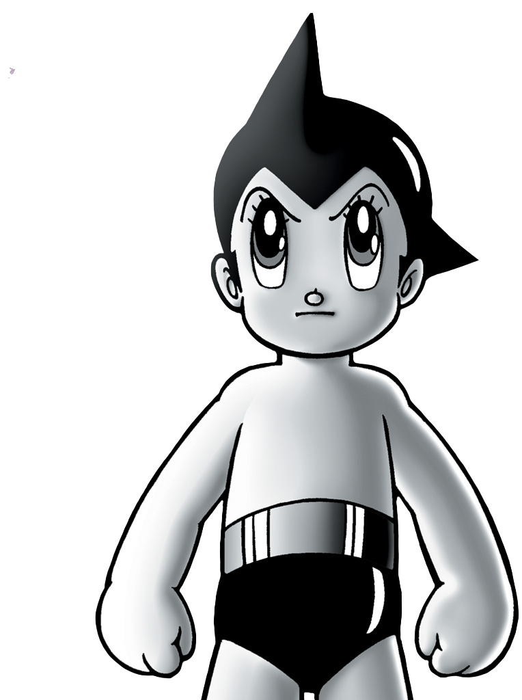
漫画
04
EDA

Slide 11
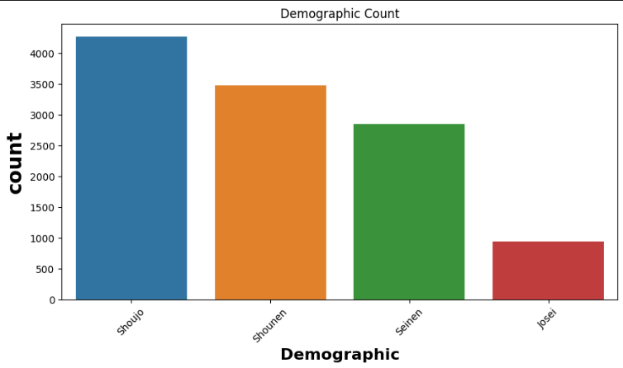
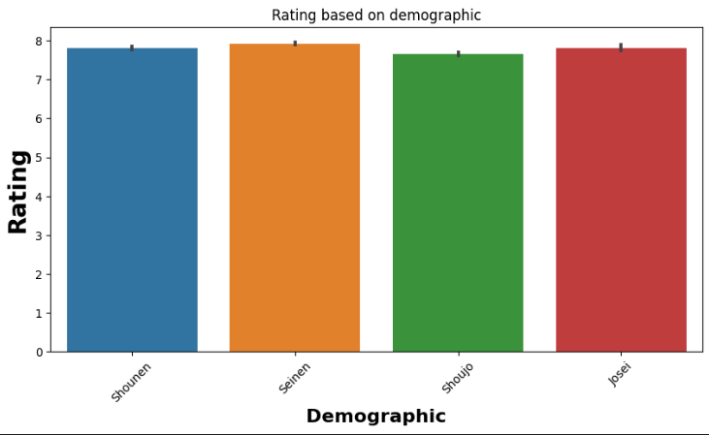
EDA

Slide 12
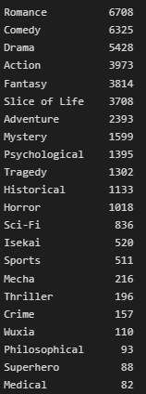
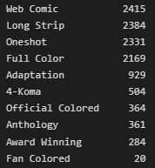
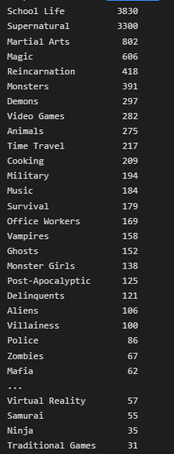
EDA

Slide 13
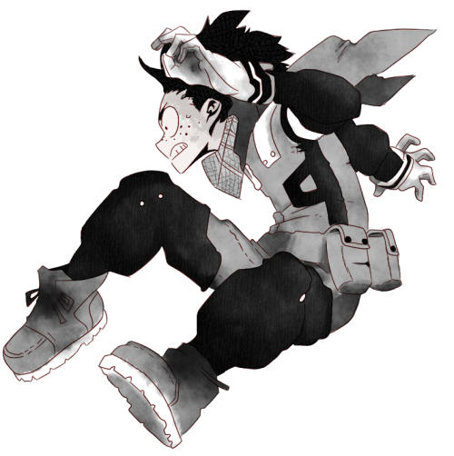
漫画
05
Model

Slide 14
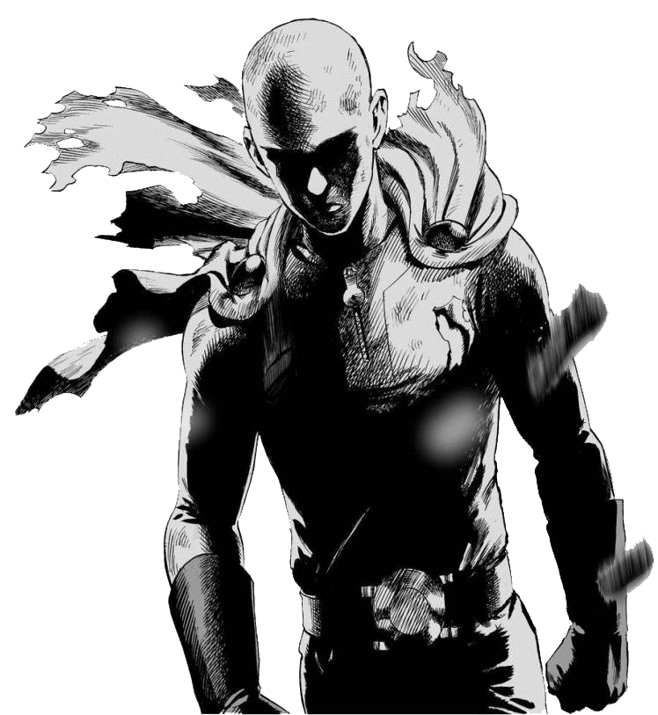
Model
The goal is to find the most similar mangas to the manga the user gives
TF-IDF was used on the description feature
Cosine similarities was also used on the description feature
Every feature has been given a certain score in case mangas have the same feature as the manga given by the user
The model then recommends the 10 most similar mangas

Slide 15
Model
All non-english descriptions were removed
All emails and urls were removed
All stop words were removed
All symbols were removed
All english tags were removed

Slide 16
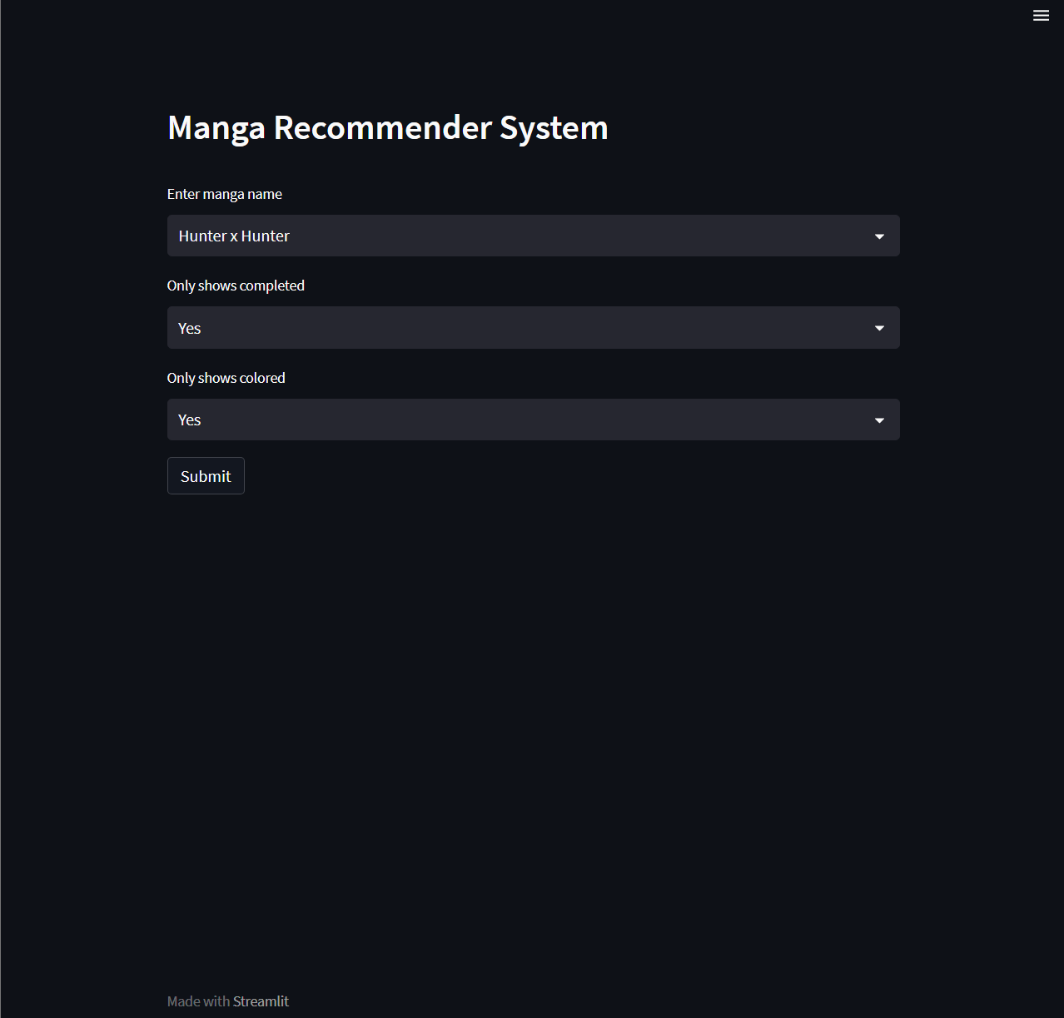
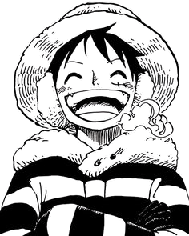
Web app demo

Slide 17

漫画
06
Future improvements

Slide 18

Future improvements
Comparing the results with other manga recommenders and see what can be done better
Trying to use K-Means clustering algorithm
Making more filtering options on the web app

Slide 19
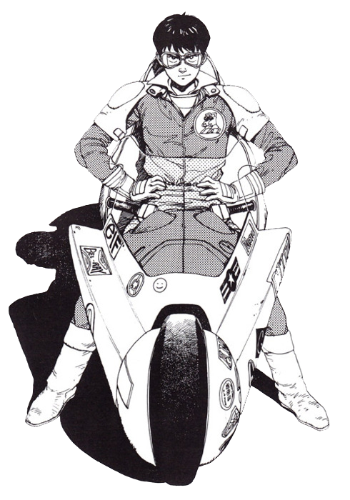


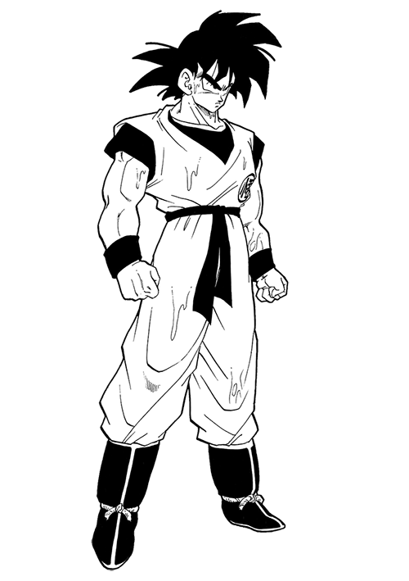
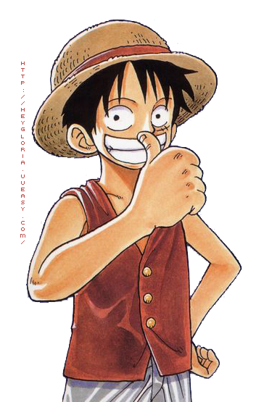
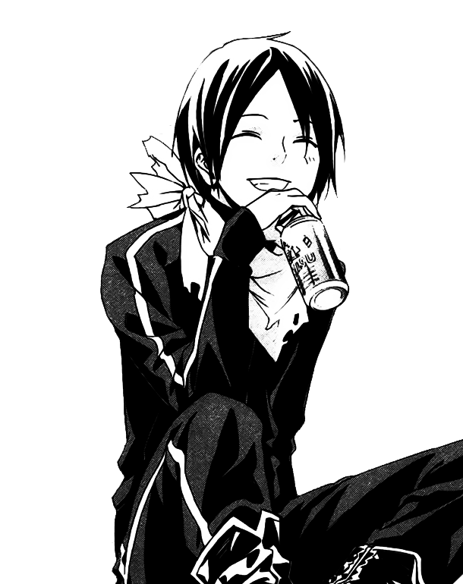
漫画
END
Thank you!

Slide 20

This template was made specially for you by:
Big shout-out to the great people that provided us with the free resources of this presentation:
SOURCE ARTICLE
https://www.widewalls.ch/magazine/japanese-manga-comics-history
STOCK IMAGES
unsplash.com
pixabay.com
Visit slidecoretemplates.com to get more editable premium presentations for free
ICONS
Thick Icons
Nice and Serious

